Slide 1

Accessing the
Supernatural
follow
Hearing
services
teams
timeline
Supernatural
Through the WORD
Matthew 13:9, 11-12

Slide 2

follow
teams
Hearing
services
timeline
Supernatural

Slide 3



1. The Supernatural Begins with Hearing
Matthew 13:9 – "Whoever has ears, let them hear."
1
2
3
follow
PRAY
ASK
DEVELOP
Hearing
services
teams
Reveals
Supernatural
Pray before reading Scripture.
Ask God, "What are You saying to me today?"
Develop sensitivity to the voice of God.

Slide 4


2. The Word Reveals Kingdom Secrets
Matthew 13:11 – ""The knowledge of the secrets of the kingdom of heaven has been given to you..."
follow
Hearing
services
Reveals
Increase
Supernatural
God’s Purpose
Healing
The power of faith
Spiritual authority
Deliverance
Eternal realities

Slide 5
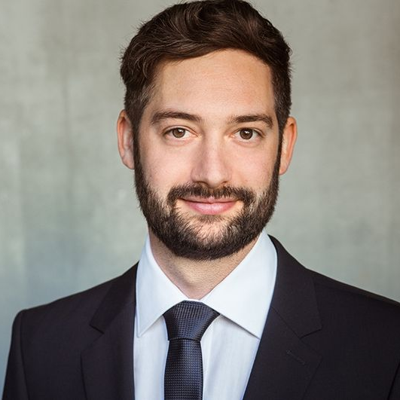
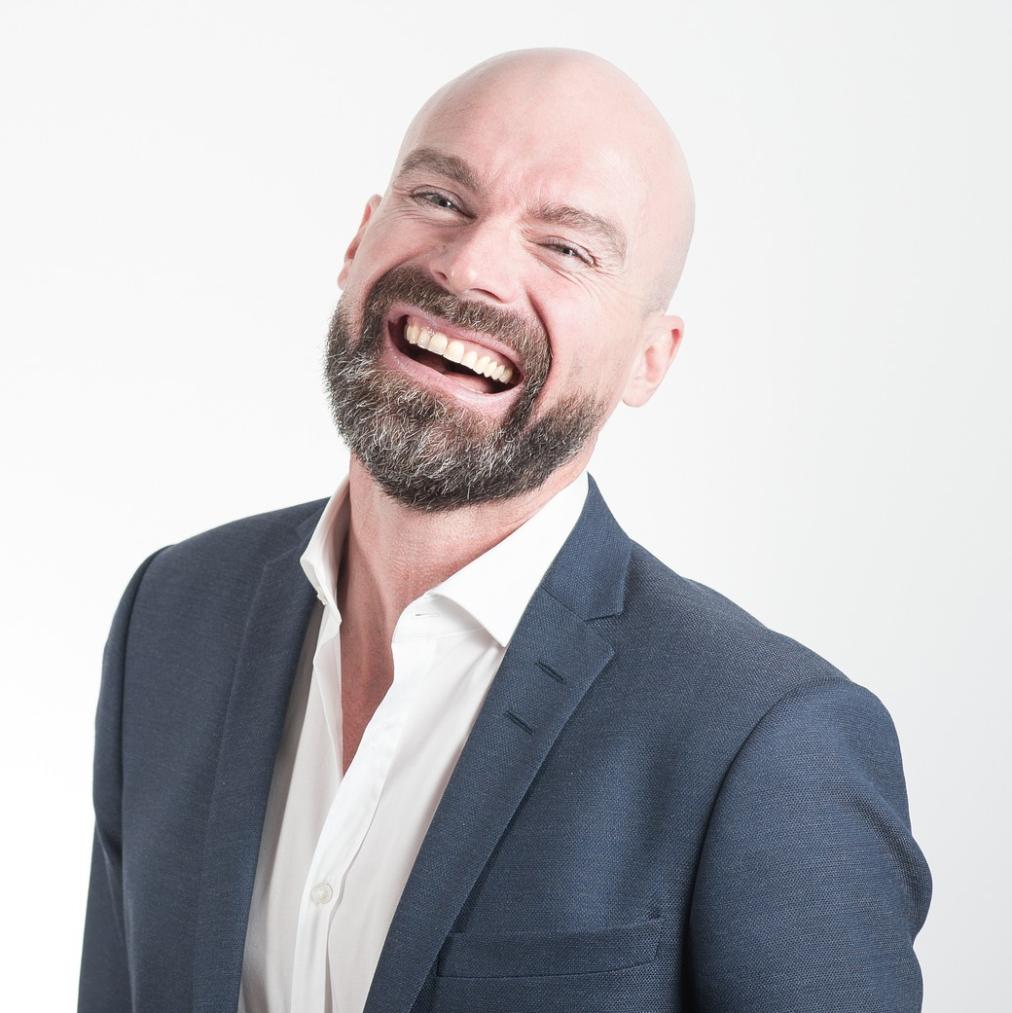
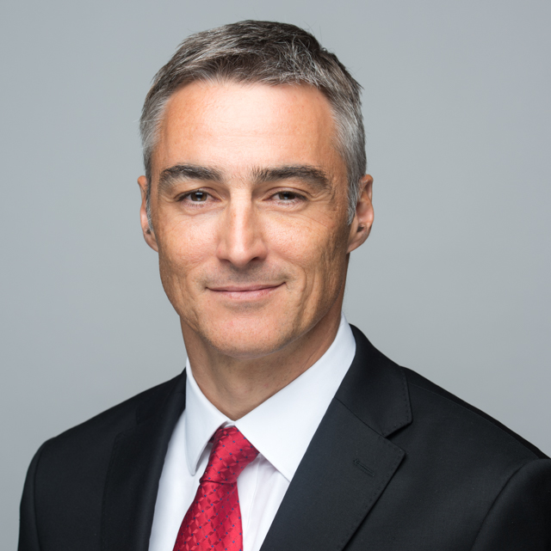
3. Revelation Increases with Response
Matthew 13:12a"Whoever has will be given more, and they will have an abundance."
01
02
03
follow
Increase
Hearing
services
Reveals
Supernatural
“When we receive and obey revelation, God entrusts us with more.”
“Spiritual growth is progressive.”
“Obedience unlocks greater understanding.”
One insight obeyed is worth more than many sermons merely heard.

Slide 6

4. Neglecting the Word Causes Spiritual Loss
Matthew 13:12b"Whoever does not have, even what they have will be taken from them."
Spiritual truths ignored eventually become forgotten.
follow
Revelation must be nurtured.
Loss
history
Increase
Reveals
about
A hardened heart loses sensitivity to God's voice.
“The danger is not lack of information but lack of response.”

Slide 7



4. Neglecting the Word Causes Spiritual Loss
Matthew 13:12"They will have an abundance."
follow
history
services
teams
timeline
about
8M
6M
7M
Add Some Brief Text Here to Explain
Add Some Brief Text Here to Explain
Add Some Brief Text Here to Explain
Humility is a lifestyle, It’s not from us it is from a Person of Jesus. DNA that we pass. - Randell Tiongson

